Slide 1

Lab 21. Tough decision maker

Slide 2
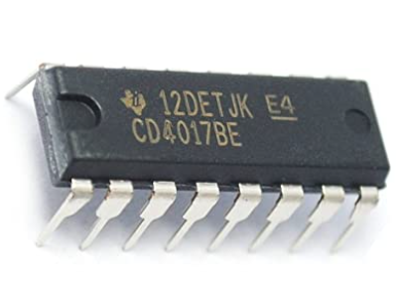
4017 IC
The CD4017 IC is a CMOS Decade counter. This CMOS IC is frequently used in designing the 10 LEDs-based circuits. It counts to 10 & also it includes 10 separate outputs. This IC includes the counter as well as the decoder.

Slide 3
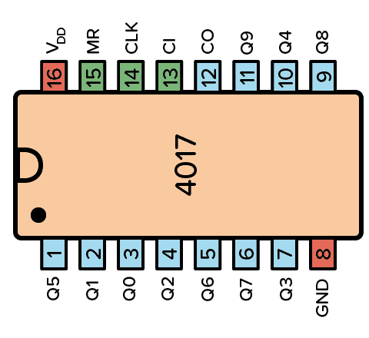
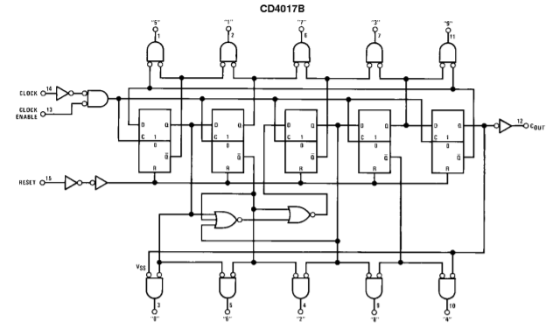
4017 IC

Slide 4
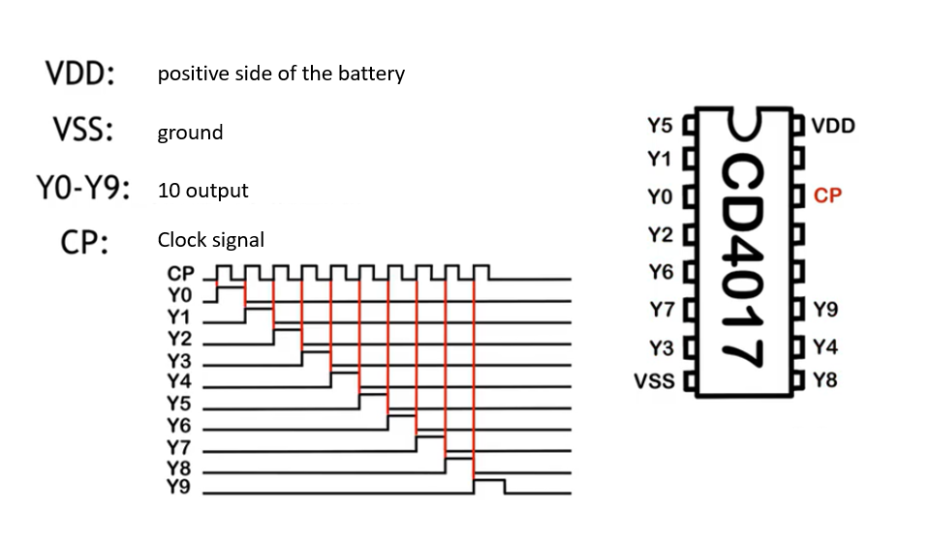
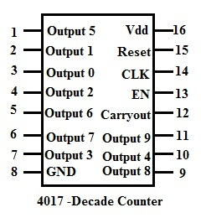

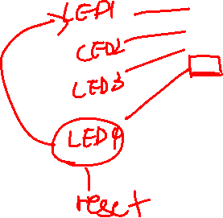

Slide 5
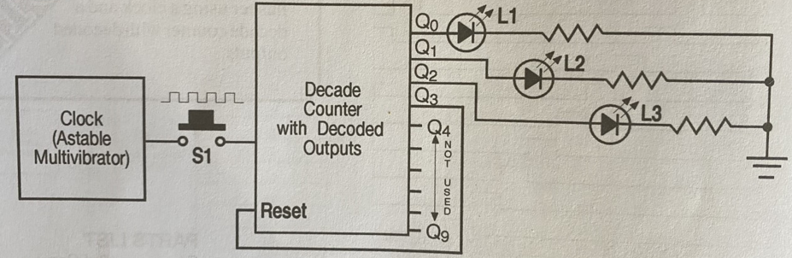
Schematic diagram

Slide 6
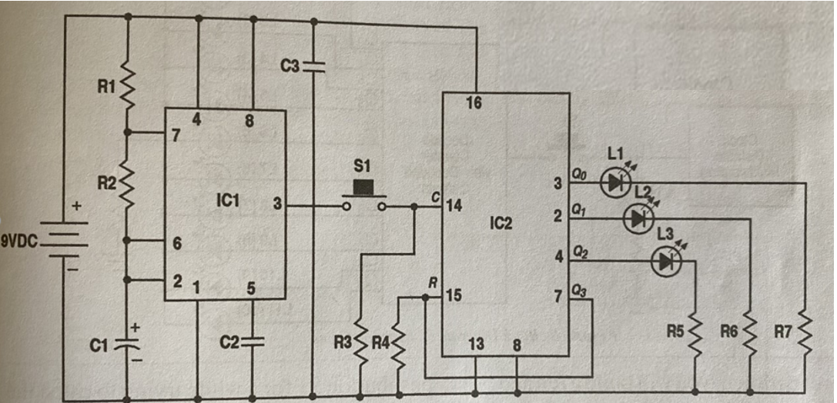
circuit diagram

Slide 7
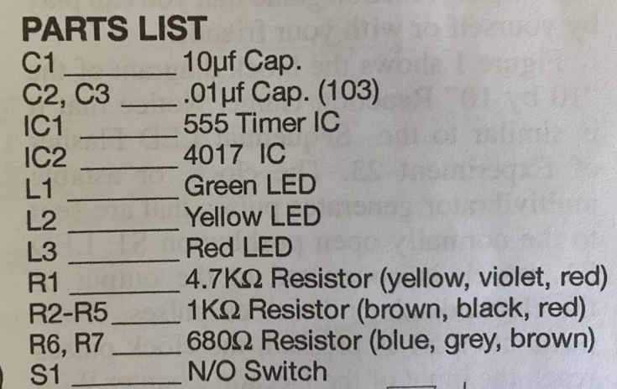
Part lists

Slide 8
Demonstration
You can work as a group, after making the connection, you both can check if the connection is correct.
Three LEDs represent YES, NO, MAYBE
After complete connection, press the switch hard and you’ll see three LEDs flash in turn
Release the switch, only one LED will be ON, that’s the decision you are going to make!

